Slide 1
Diwali Sales Data Analysis
Abhijit Bhunia
bhuniaabhijit721644@gmail.com

Slide 2
OUTLINE
Executive Summary
Introduction
Project Goals
Methodology
Result
Observation
Conclusion

Slide 3
Executive Summary
This report presents a comprehensive analysis of Diwali sale data collected from various sources, aimed at uncovering insights and trends to optimize future marketing strategies and enhance sales performance.
Key Objectives:
Sales Performance Evaluation: Assessing the overall sales performance during the Diwali season across different product categories.
Customer Segmentation: Identifying customer segments based on purchasing behavior and demographics to tailor marketing efforts.
Product Performance Analysis: Evaluating the performance of specific products and categories to understand popularity and profitability.
Competitive Analysis: Analyzing competitors' strategies and market positioning during the Diwali period.

Slide 4
Introduction
Diwali, also known as the Festival of Lights.
The festival of Diwali marks not only a cultural celebration but also a significant period for businesses across India, characterized by heightened consumer spending and vibrant market activity. This report delves into the analysis of Diwali sale data, aiming to extract valuable insights that can inform strategic decisions and optimize performance in subsequent festive seasons.

Slide 5
Project Goals
The primary goals of this Diwali sale data analysis project are to:
Evaluate Sales Performance: Assess the overall sales performance during the Diwali season across various product categories and sales channels.
Customer Segmentation: Identify and segment customers based on purchasing behavior, demographics, and preferences during the Diwali period.
Product Performance Analysis: Analyze the performance of specific products and categories to understand popularity, profitability, and seasonal trends.
Competitive Analysis: Evaluate competitors' strategies, pricing, promotions, and market positioning during the Diwali season to benchmark performance and identify areas for improvement.
Recommendations for Optimization: Provide actionable recommendations based on data insights to optimize marketing strategies, inventory management, pricing strategies, and overall business operations for future Diwali sales.

Slide 6
Methodology
Data Collection: Gather sales data from company records including transactional data, sales volumes, product categories, and customer demographics specific to the Diwali period over the past year.
Data Cleaning and Preparation:
Cleanse and preprocess raw data to ensure accuracy and consistency.
Handle missing values, outliers, and ensure data is formatted correctly for analysis.
Exploratory Data Analysis (EDA):
Conduct exploratory analysis to understand the distribution of key variables, trends over time, and relationships between variables such as sales volume, pricing, and promotional activities.
Visualize data using charts, graphs, and statistical measures to uncover initial insights.
Also uses Some Library file like Pandas,matplotlib,etc.

Slide 7
Result
Analysis Parameter:
Gender
Marriage Status
Age Group
Product Category
State
Product ID
Occupation

Slide 8
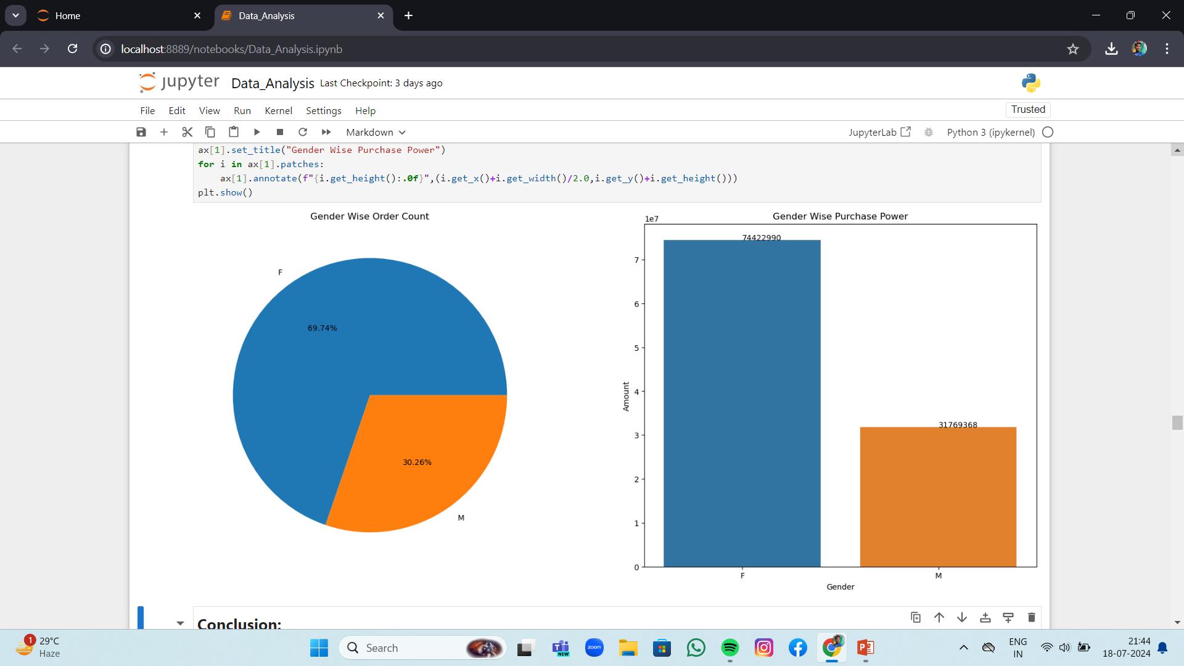
Gender Wise

Slide 9
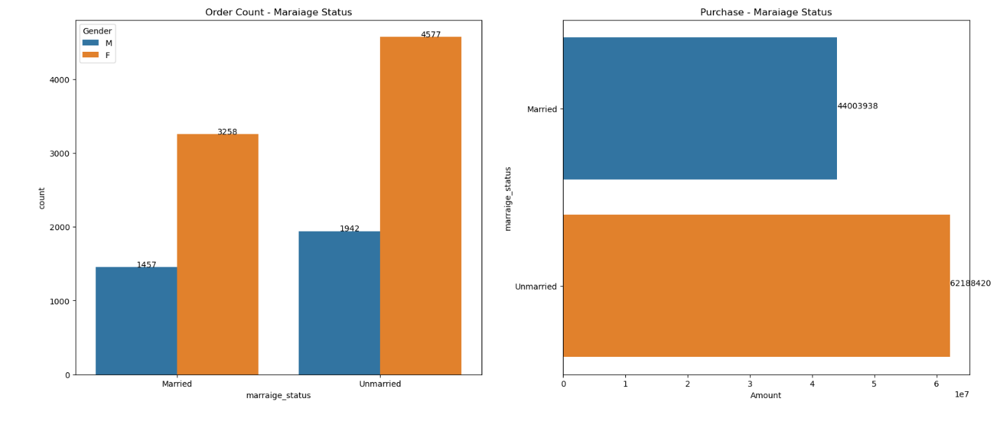
Marital status Wise

Slide 10
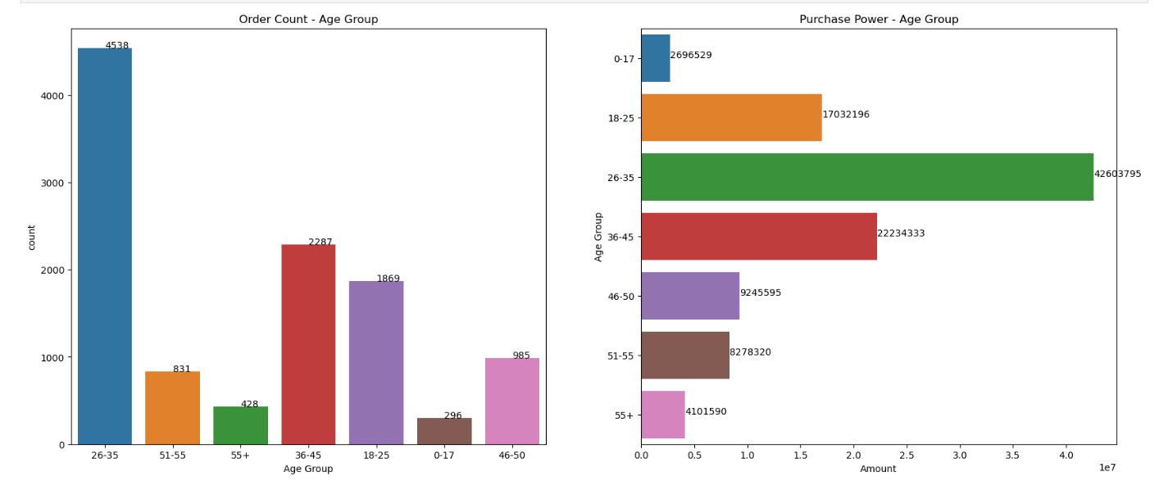
Age Group Wise

Slide 11
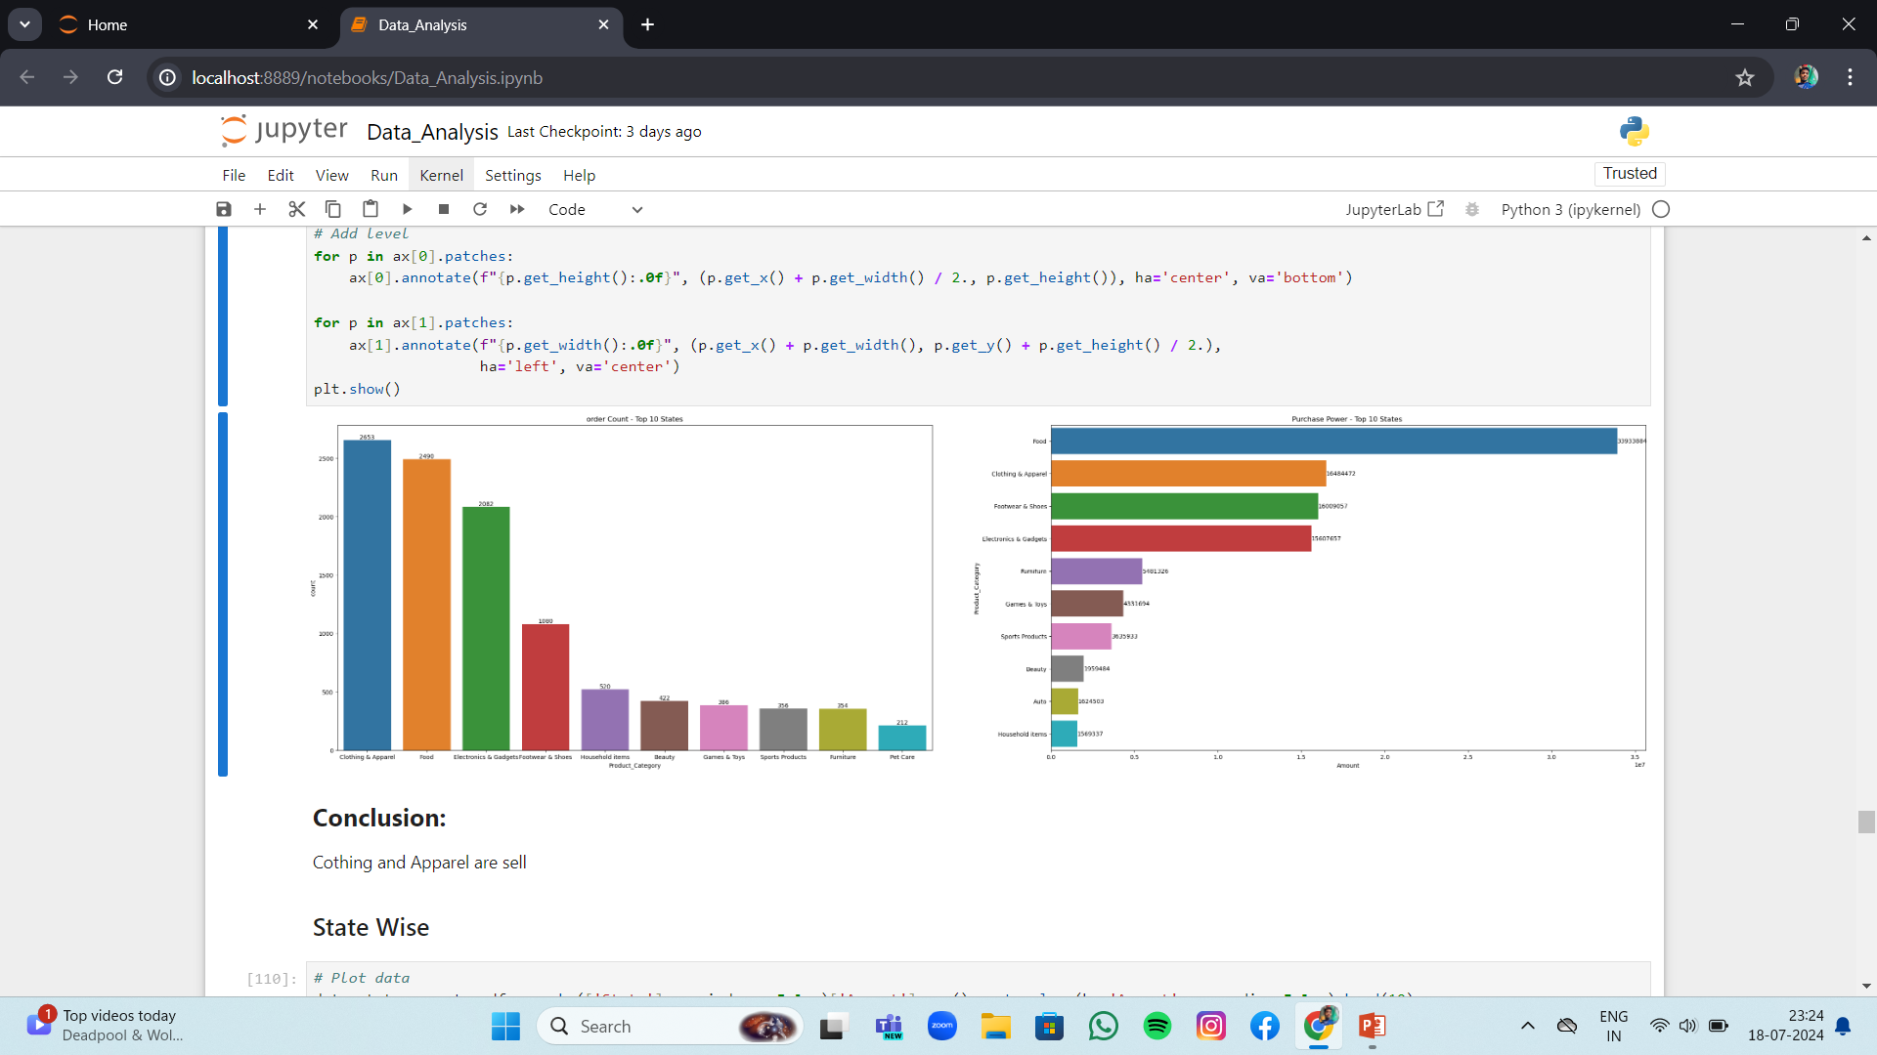
Product Category Wise

Slide 12
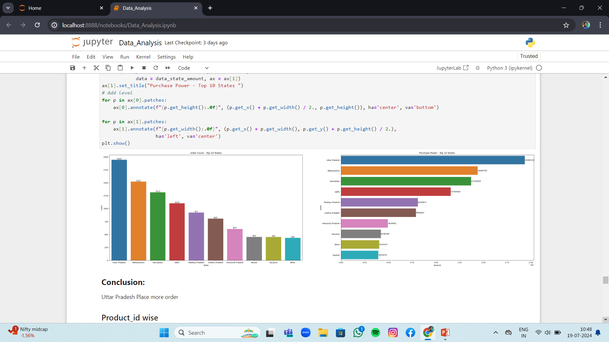
State Wise

Slide 13
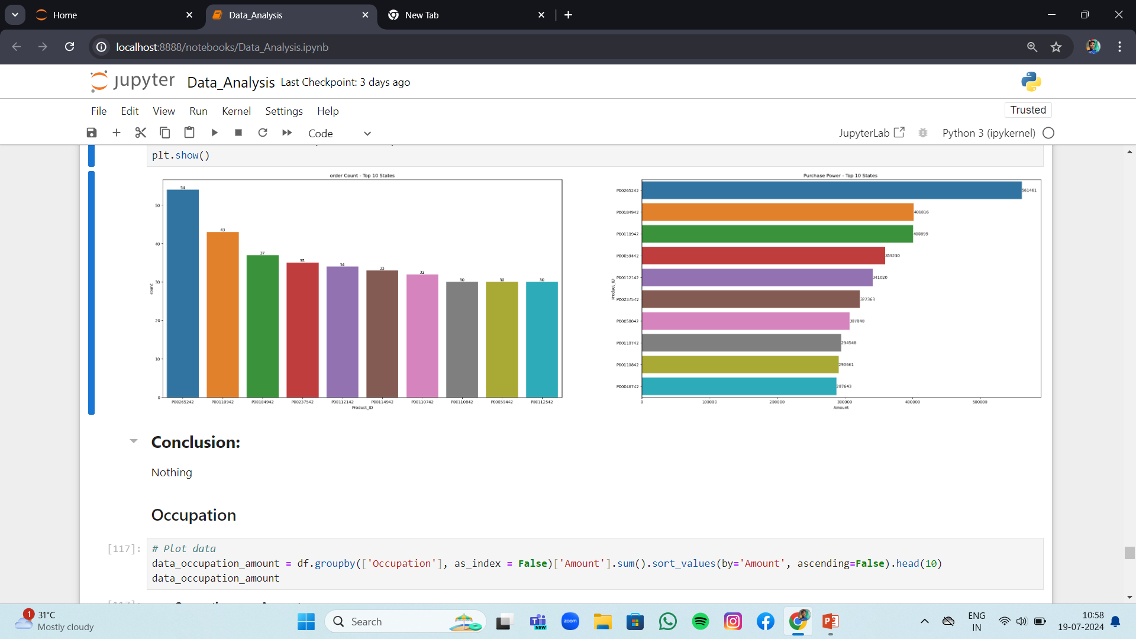
Product ID Wise

Slide 14
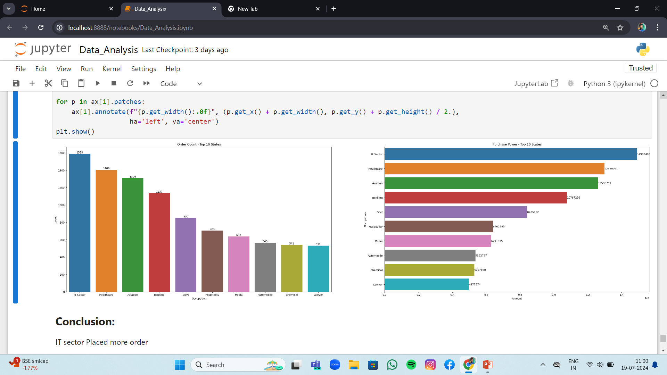
Occupation Wise

Slide 15
Observation
Gender
From our Analysis & graph we can see that most of the products buyer are females and Also the purchasing power of females are greater than males.
Marriage Status
On the basis of our graph we can find that the order count of products is higher for females in both married and unmarried and the Purchase power is higher for the unmarried Peoples.
Age Group
From our analysis we can see that most of the buyers are of age group btw 26-35 years females.
Product Category
From graph we can see that most of the sold products are from Clothing and Apparel, Food ,Electronics Section.
State
We observe that most of the orders are from Uttar Pradesh ,Maharashtra and Karnataka State.
Occupation
From our observation most of the buyers are from IT Professional.

Slide 16
Conclusion
Gender:
Tailor marketing strategies based on gender preferences. For instance, focus on electronics for males and clothing and Appeals for females.
Marriage Status:
Offer promotions that appeal to both married and unmarried individuals. Consider special discounts on larger purchases for unmarried Peoples.
Age Group:
Segment marketing efforts to cater to different 26-35 years preferences. Highlight specific product categories that appeal most to each age segment.
Product Category:
Allocate resources and inventory based on the popularity of product categories during Diwali. Focus marketing campaigns on high-demand categories like electronics ,clothing Apparels and Food.
State:
Customize promotions and inventory management based on regional preferences. Consider regional variations in product preferences and adjust strategies accordingly.
Occupation:
Tailor messaging and promotions to different occupational groups. Offer discounts or bundles that resonate with the spending habits of professionals.

Slide 17


